Slide 1
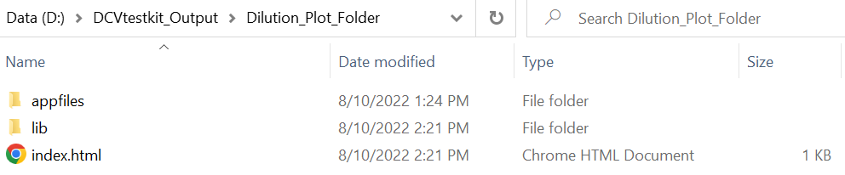
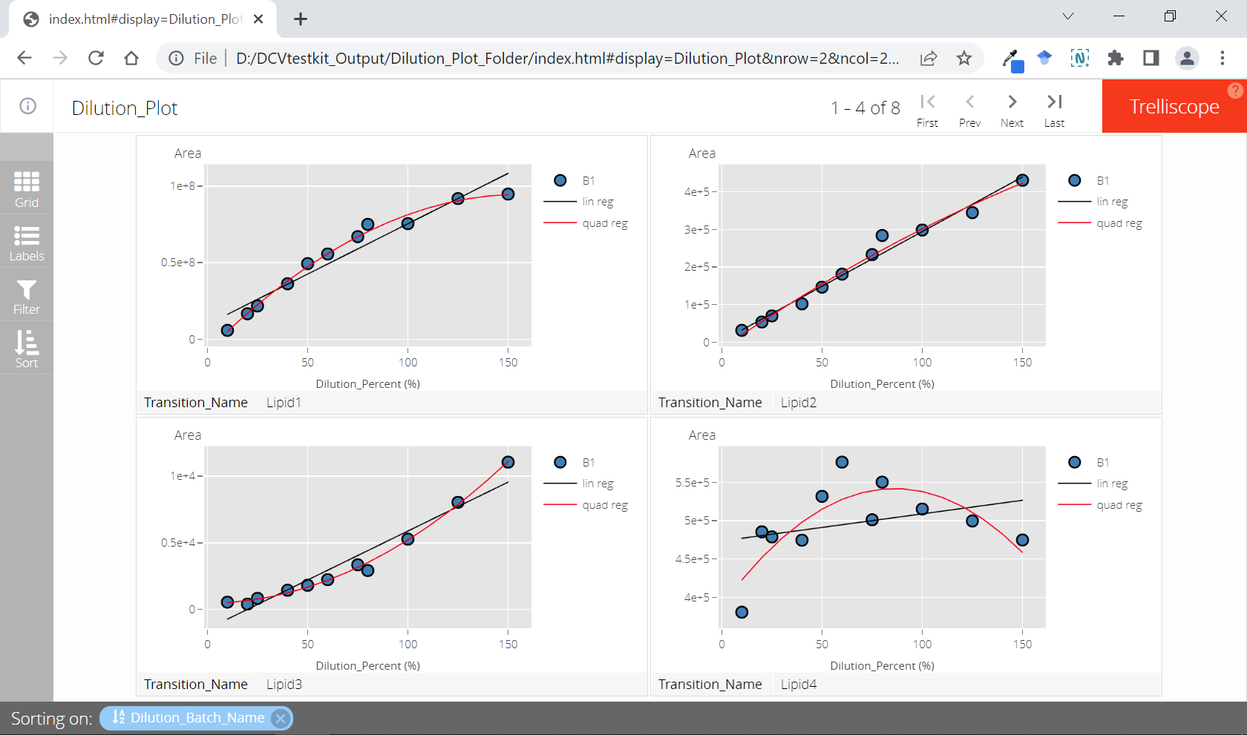

Slide 2
Is Linear
Identify non-linear relationship

Slide 3
Correlation Coefficient (R)
>= 0.8
Percent Residual Accuracy
>= 80%
Good Linearity
< 0.8
< 80%
Poor Linearity

Slide 4
Correlation Coefficient (R)
>= 0.8
Percent Residual Accuracy
>= 80%
Good Linearity
< 0.8
< 80%
Neg
Saturation
Mandel Fitting Test
p value
Concavity
< 0.05
Limit of Detection
>= 0.05
Pos
Poor Linearity

Slide 5
Workflow 1
Correlation Coefficient (R)
>= 0.8
Percent Residual Accuracy
>= 80%
Good Linearity
< 0.8
< 80%
Poor Linearity
Workflow 2
Correlation Coefficient (R)
>= 0.8
Percent Residual Accuracy
>= 80%
Good Linearity
< 0.8
< 80%
Neg
Saturation
Mandel Fitting Test
p value
Concavity
< 0.05
Limit of Detection
>= 0.05
Pos
Poor Linearity

